Slide 1
Printmarket
now
Quantity: amount of copies send to wholesalers
Remission: Quantity – sales
Remission quota: remission / quantity
We send copies to wholesaler
Wholesaler distributes to the shops
Wholesaler has to achieve a given remission quota for different shops
That‘s how we try to take influence of the distribution to shops
BILD einfügen was den Verlauf zeigt evtl.

Slide 2
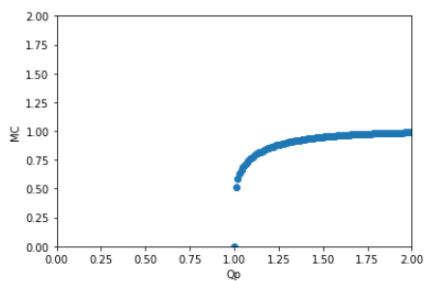
Printmarket
now
Find optimal remission quota for every wholesaler
Divide every shop in sales-class (by sales mean) and variation-class (by sales standard deviation)
For every class calculate QP(transformation of RQ) – MC (market coverage) -curve:
Optimum: where marginal sales are equal for every class
Dependant on distribution of classes, every wholesaler gets another optimal RQ

Slide 3
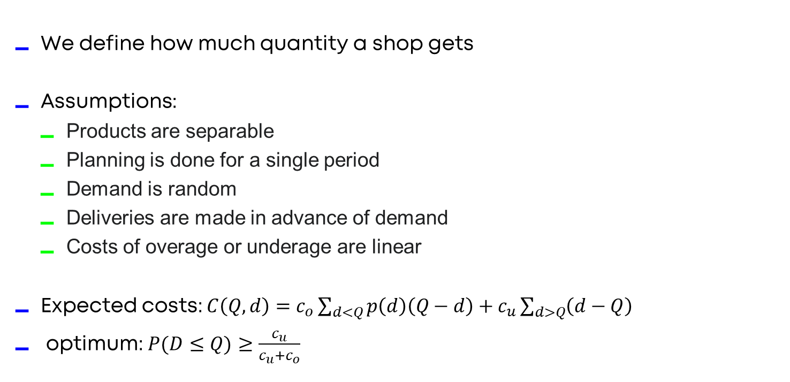
Printmarket
Newsvendormodel

Slide 4
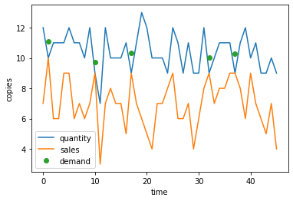
Printmarket
Newsvendormodel
Demand estimation, survival analysis
Cox proportional hazard model, better than KM
Features:
Sales mean
Sales std
Relative sales compared to equal shops
Sold-out-quota of shops around

Slide 5
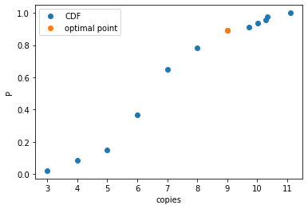
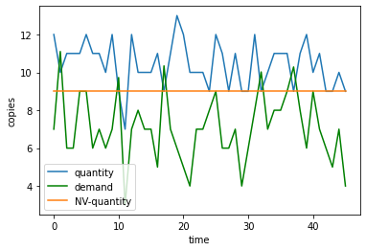
Printmarket
Newsvendormodel
Estimation of distribution function
Empirical distribution function
Critical point: 0.88029

